Slide 1
Artificial Intelligence for Games Week 7 – FEAR + Company of Heroes Steve Rabin
For help on projects, email everyone (select and copy this string from the start of any class PowerPoint):
steve.rabin@gmail.com, p.jiankai@digipen.edu, b.hsu@digipen.edu, zak.s@digipen.edu, keaton.sullivan@digipen.edu, john.tseng@digipen.edu, a.roulst@digipen.edu
TAs: Jian Kai Phua, Brandon Hsu, Zak Stephenson, Keaton Sullivan, John Tseng, Andrew Roulst

Slide 2
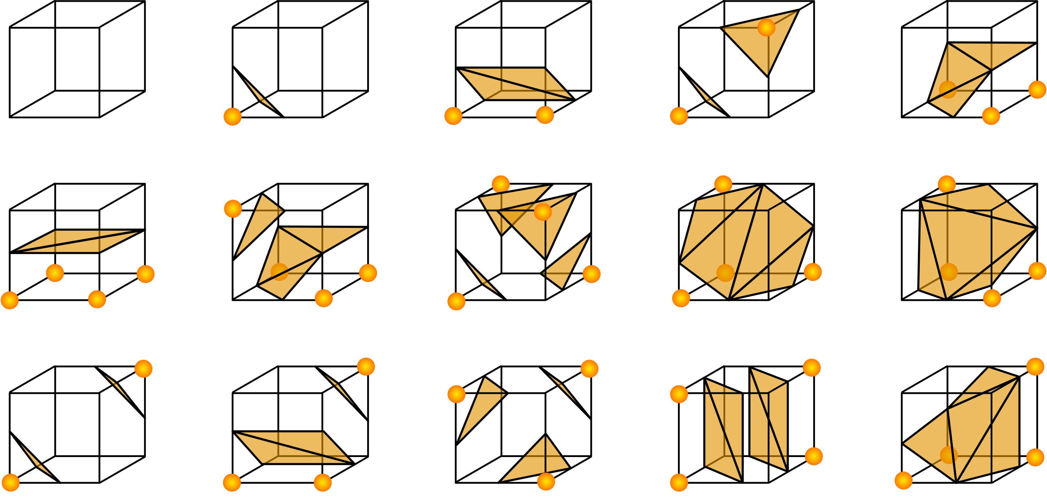
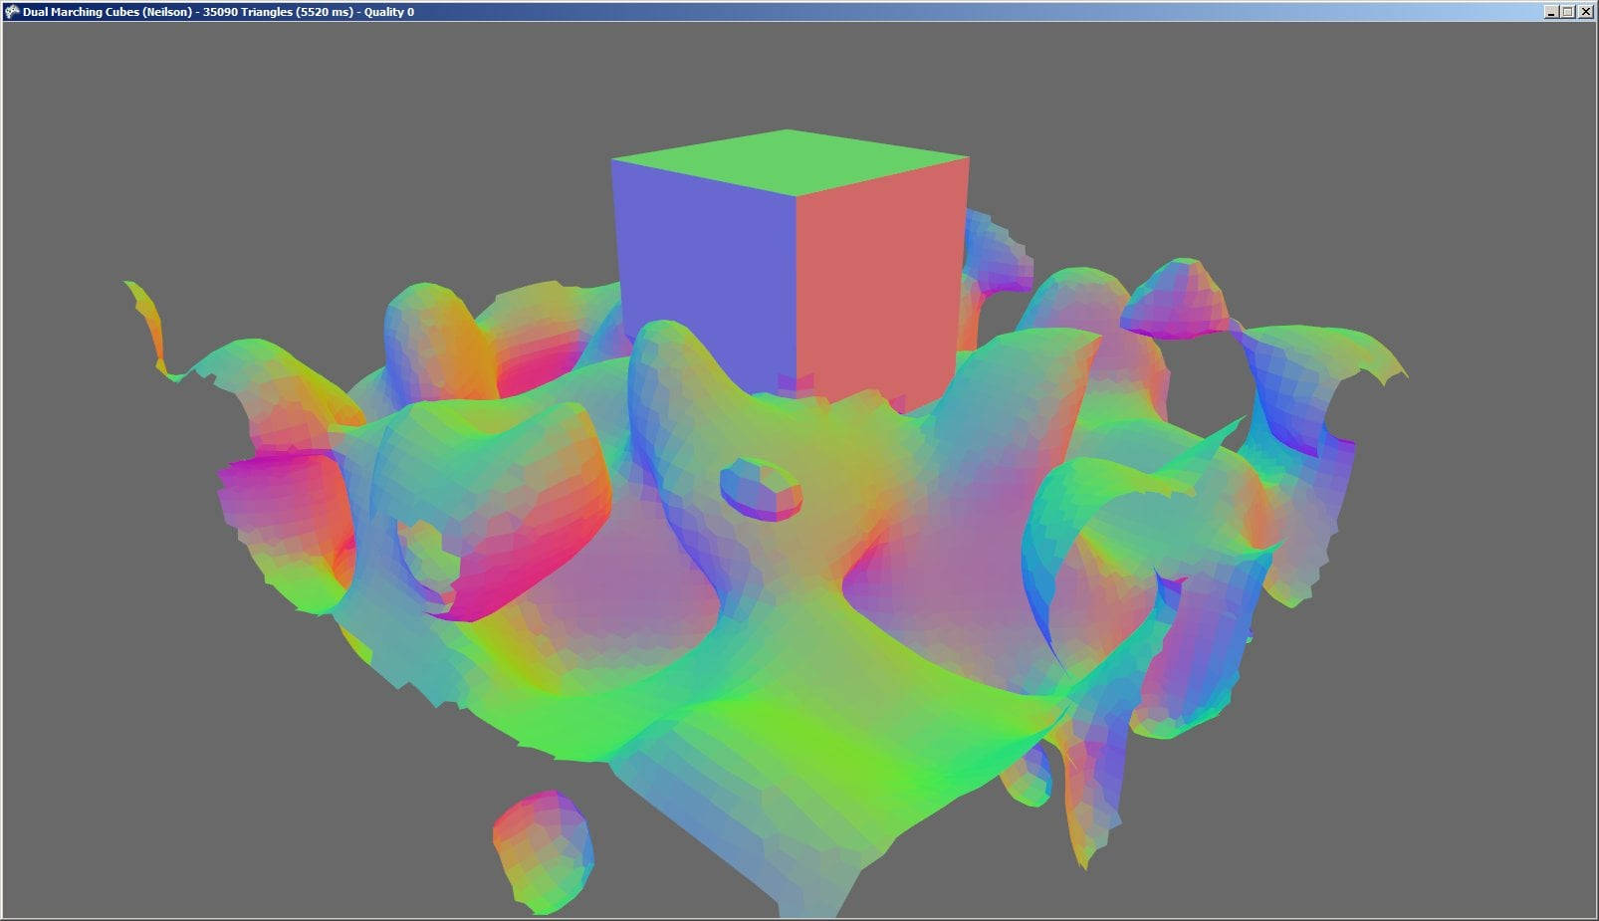
Questions
What were the 5 PCG strategies we talked about?
Why can’t you procedurally generate infinite novelty?
What is the name for the inside/outside vertex technique?
Anyone know what Marching Cubes is?

Slide 3
Questions
The Flame and the Flood combined which PCG strategies?
All but gramars
In The Flame and the Flood, how was constructionist used?
In The Flame and the Flood, how was constraint-driven used?
In The Flame and the Flood, how was optimization-based used?
Wiggle pieces together
In The Flame and the Flood, how was the river flow simulated?
River flow
What is Rabin’s least favorite PCG strategy?
gramars

